Slide 1
Monitoring and Operation’s View

Slide 2
Table of Contents
Overview
1
Monitor Message Processing
2
Manage Integration Content
3
Manage Security
4
Manage Stores
5
6
Test Connectivity
Logs
7

Slide 3
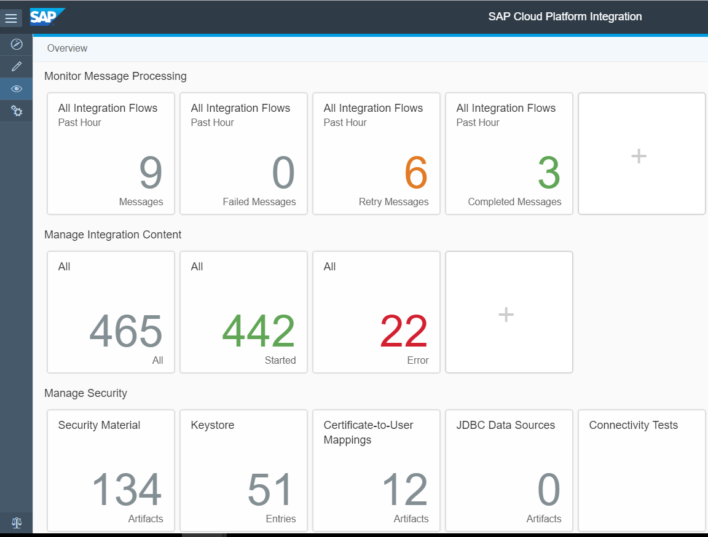
1.Monitoring – Overview
Main aspects of monitoring are
Monitor Message Processing
Manage Integration content
Message Processing allows us to check the status of messages
Manage Integration Content allows us to monitor the Iflow’s for a tenant
Each aspects contains various status within the components.
Additional tile can be added based on the Artifacts
These tiles can be edited/ deleted based on the user
CPI monitoring has the capability that lists the step where message failed in an Ilfow via graphical view.

Slide 4
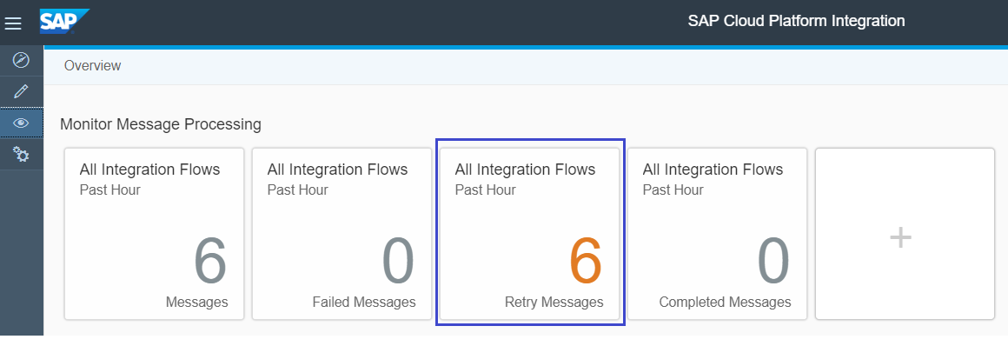
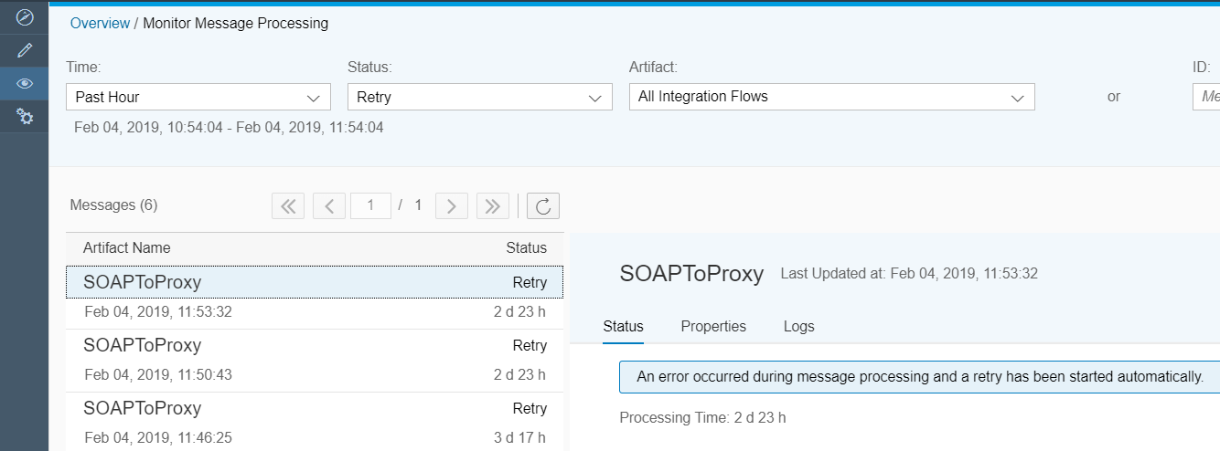
2.Monitor Message Processing
It provides number and status of processed messages within a specified time.
Various Status of messages are
Failed
Retry
Completed
Processing
Escalated
Each tile collects the messages processed in CPI based on the status.
We can add more tiles as per requirement and set the filtering conditions as per our requirement.
Standard packages have to copied to Own workspace and deployed by providing connectivity details

Slide 5
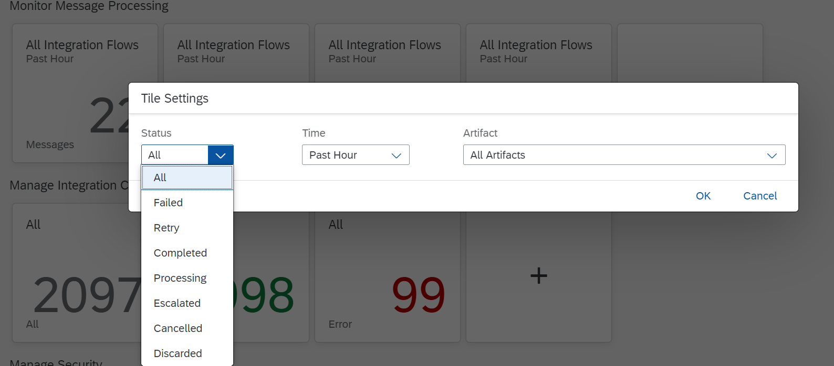
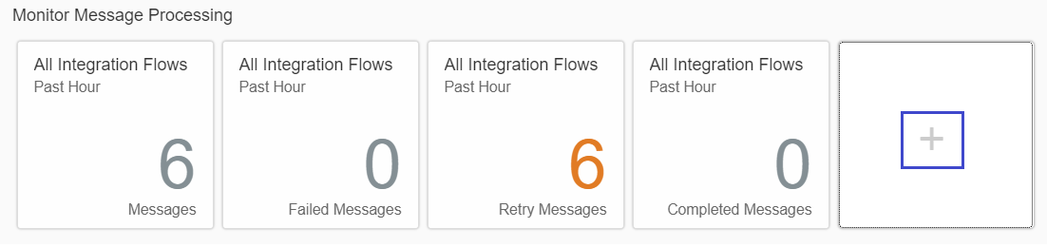
2.Monitor Message Processing
Message Status
Completed: Message Processing completed and the message delivered to the receiver successfully
Failed: Message Processing failed, re-try not possible
Retry: Error Occurred –during message processing and retry started automatically.
Processing: Message is currently being processed
Escalated: Error occurred during the message processing but message retry not started automatically. For synchronous interfaces error message is sent to the sender.
Cancelled: Manual cancellation of entries in the JMS queue - MPL is set to status cancelled.
Discarded: For scheduler triggered integration flows, the MPL is shown on the worker node where the message processing started first. For all subsequent message processing starts, the message status is set to Discarded.
Additional status tiles can be added for specific status. Filter to be set based on 3 factors.
Status
Time
Artifact

Slide 6
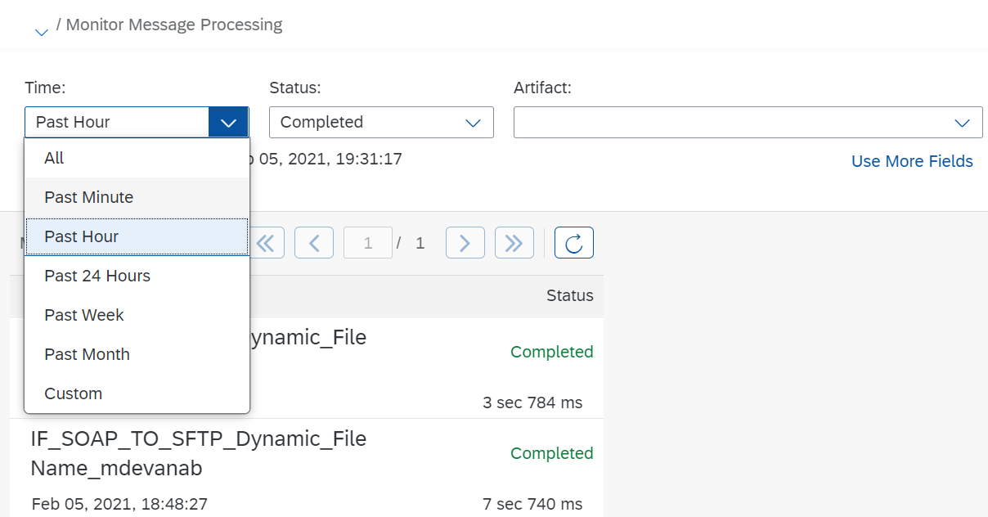
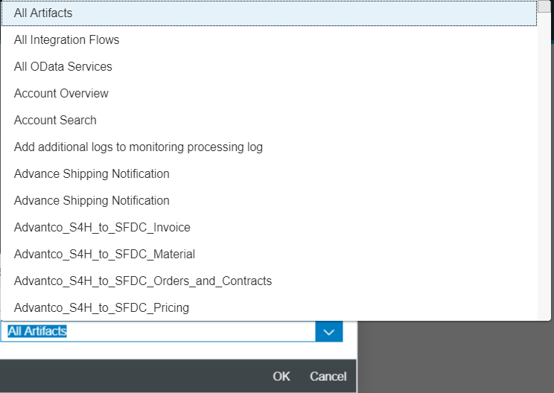
2.Monitor Message Processing
Status Attributes
It allows to filter message by status.
Time Attribute
It allows to select the status of messages at predefined intervals.
Artifact Attribute
It allows to search messages associated with specific artifacts.
Dropdown list display the artifacts deployed on the tenant.
Integration Flow
Odata Services
Account Overview
Account Search

Slide 7
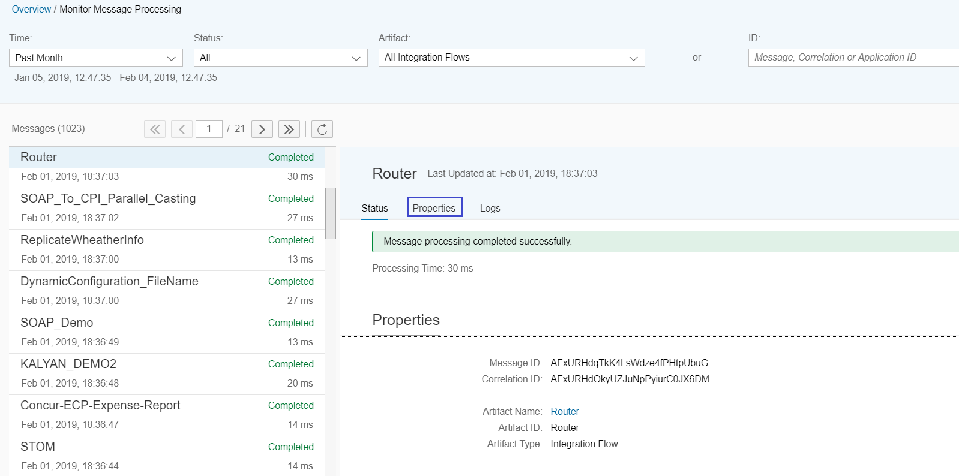
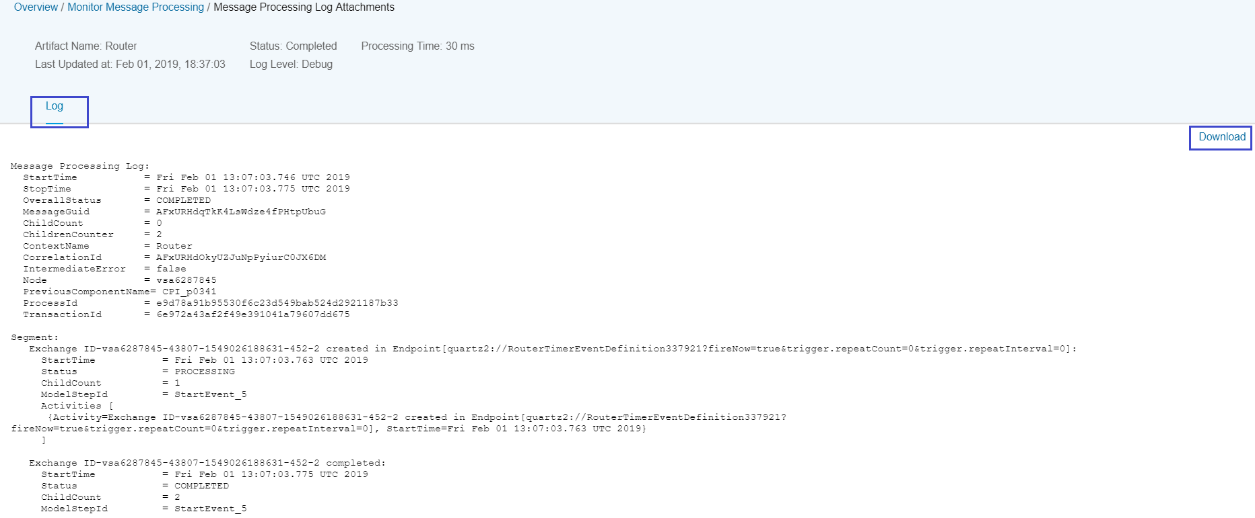
2.Monitor Message Log
Every message processing contains lists Status, Properties and Logs.
Properties contains the Artifact details, Message ID and Correlation ID.
Log stores the structured information related to the message processed end to end by an artifact such as Integration flow.
Logs are stored based on the mode set in Manage Integration content specific to the Artifact.
Message processing logs can be download as a file.

Slide 8
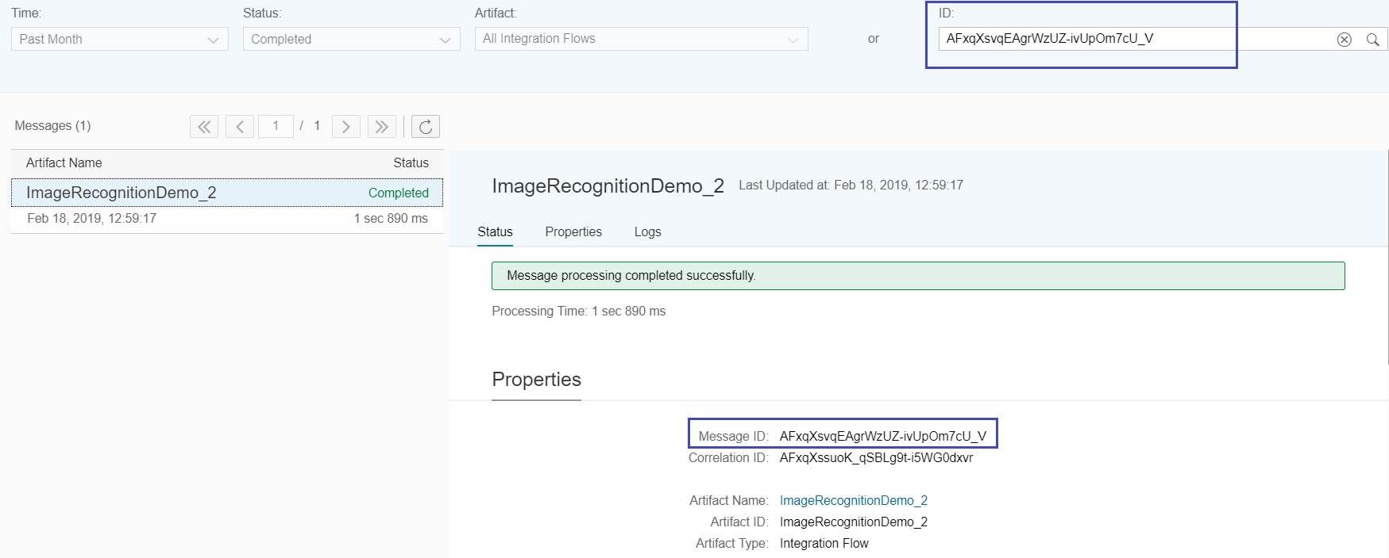
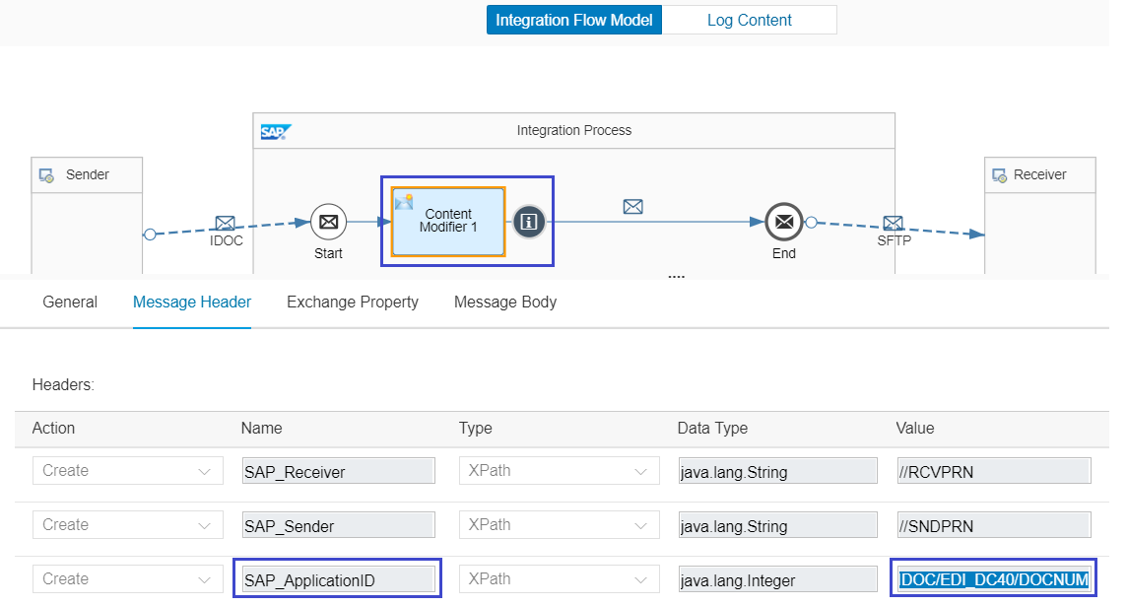
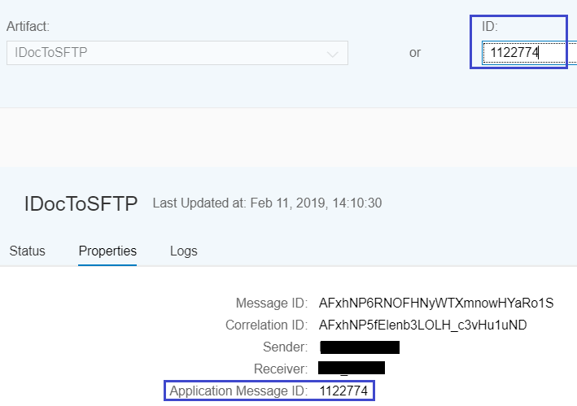
2.Monitor Message ID’s
ID’s allows display/ filter messages associated with a specific unique value. Filtering messages by this attribute is helpful for support use cases (to do root cause analysis).
Message ID: Identifies the message uniquely.
Correlation ID: Identifies correlated messages.
Application ID: Identifier sent from SAP Example IDOC Number.
Is set when an SAP_ApplicationID header element is specified in the associated integration flow in the Content Modifier step.

Slide 9
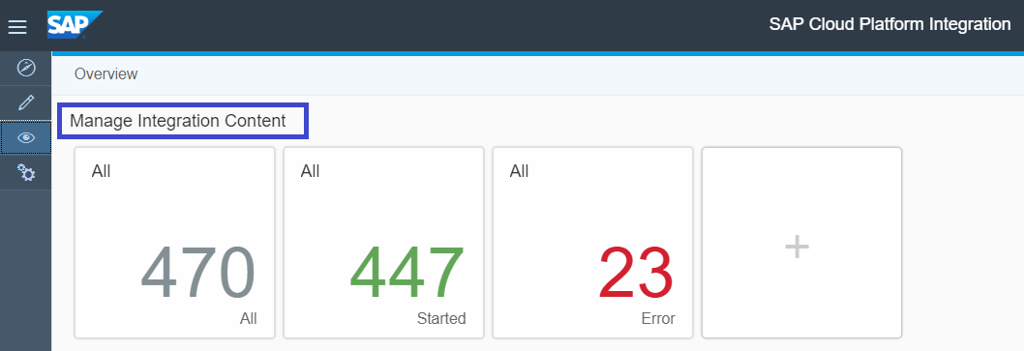
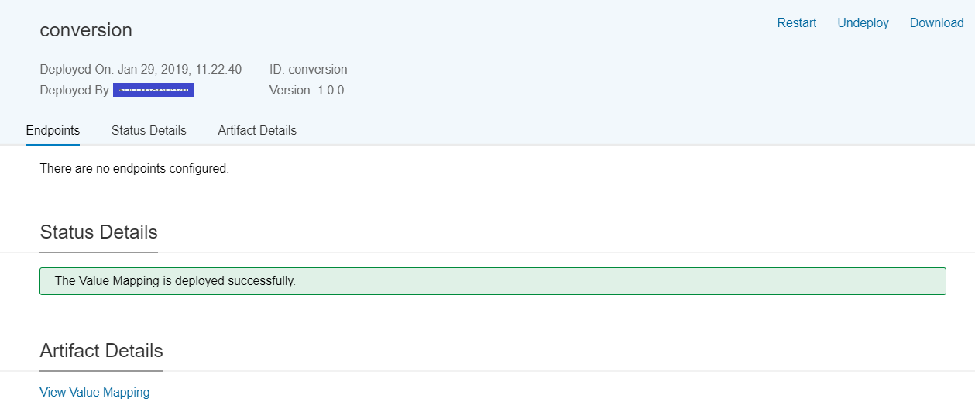
3.Manage Integration Content
It provides overview of the integration artifacts such as Integration flows and Security related artifacts such as ODATA service, Value Mapping deployed on the tenant
It display’s status of the Individual artifacts
Various status with Integration content monitor are
Starting: Component is currently being starting. For a deployable component this means: the component is deployed.
Started: Component is started on selected runtime Node
Stopping: Component is currently being stopped
Error: Component ended with error and displayed with error description

Slide 10
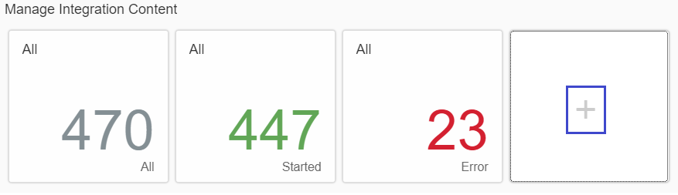
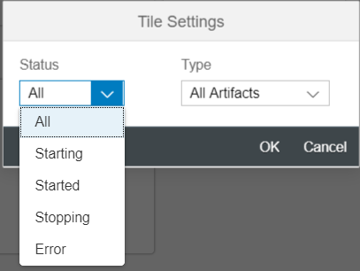
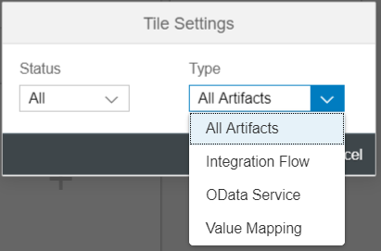
3.Manage Integration Content
Additional status tiles can be added for specific status. While adding, message filter to be set based on 3 factors.
Status
Artifact
Integration Content details are collected based on the status. For each artifact Endpoint, Status details, Artifact details and Log configuration are listed
Log level can be set with below level
Info
Debug
Trace
None

Slide 11
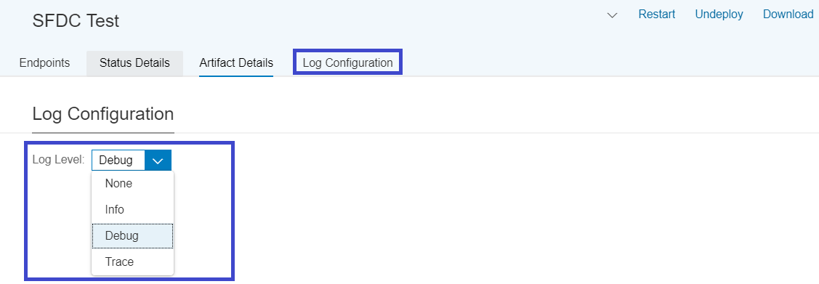
3.Manage Integration Content
The log level for the message processing log specifies the granularity of information collected by the message processing log
None: No Data is recorded during message processing and no data is shown in data monitoring.
Info: Basic information is recorded during message processing. The header is always displayed and in case of failed messages.
Debug: Detailed information is recorded for all steps during message processing. The header and additional information about the last 100 steps are displayed in the message processing log..
Trace: Detailed information is recorded for all steps and in addition, the message content is tracked . The trace function expires after a certain time (default value: 10 minutes). The recorded message content is also retained for a certain time (default value: 1 hour).

Slide 12
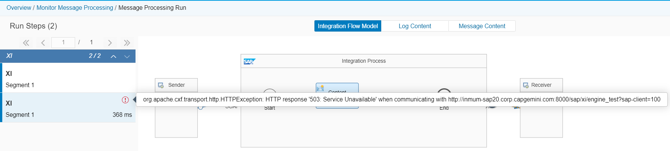
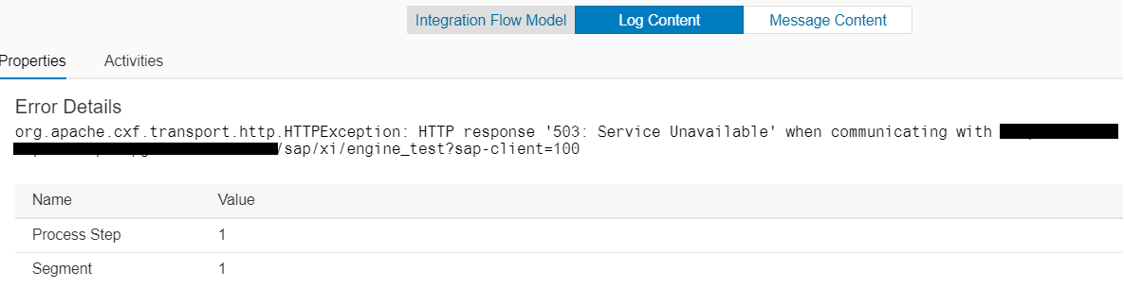
3.Manage Integration Content
Trace level is activated in Integration content. When the message fails, Integration Flow model shows the step where the message failed.
Log Content shows the detailed error

Slide 13
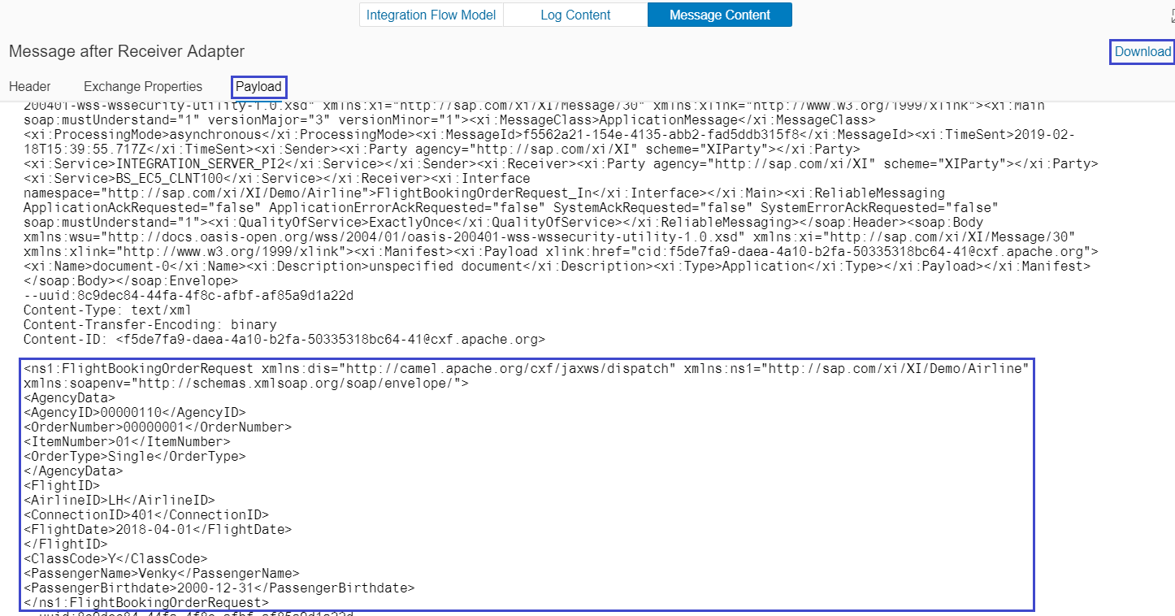
3.Manage Integration Content
Message Content stores the payload at the steps of message execution

Slide 14
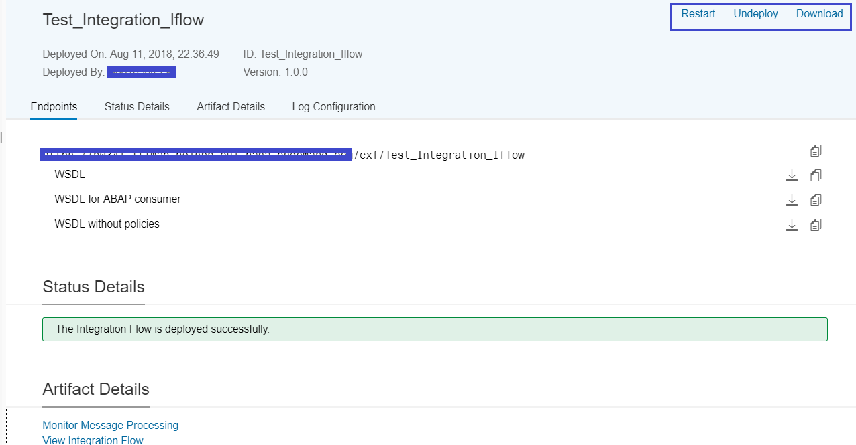
3.Manage Integration Content
Attributes of Integration Content Artifact
For each Artifact following attributes are displayed.
Artifact name: It provides the name of the artifact
Deployed On: Indicates the timestamp of deployment
Deployed By: Indicates the user who deployed
Version: It displays the Integration flow version
Restart: It allows to restart the deployment of the artifact
Un-Deploy: It allows the deployed artifact to un-deploy to prevent message processing
Endpoints: URL for Integration flow is generated along with WSDL which can be downloaded

Slide 15
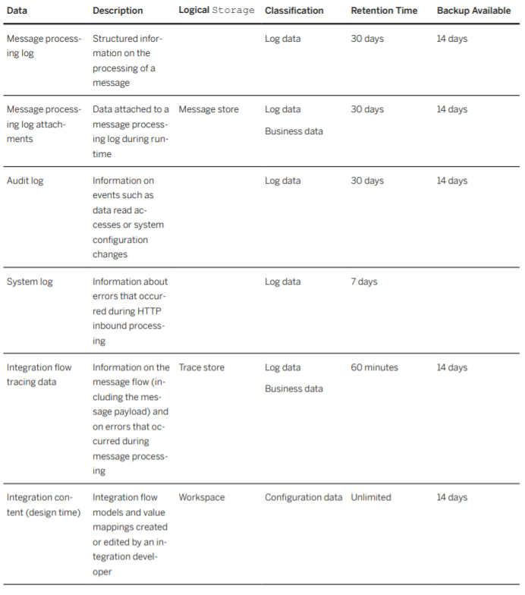
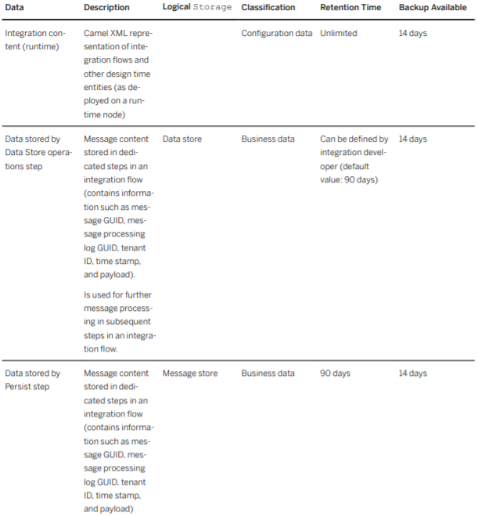
Lifecycle of Data processed in CPI

Slide 16
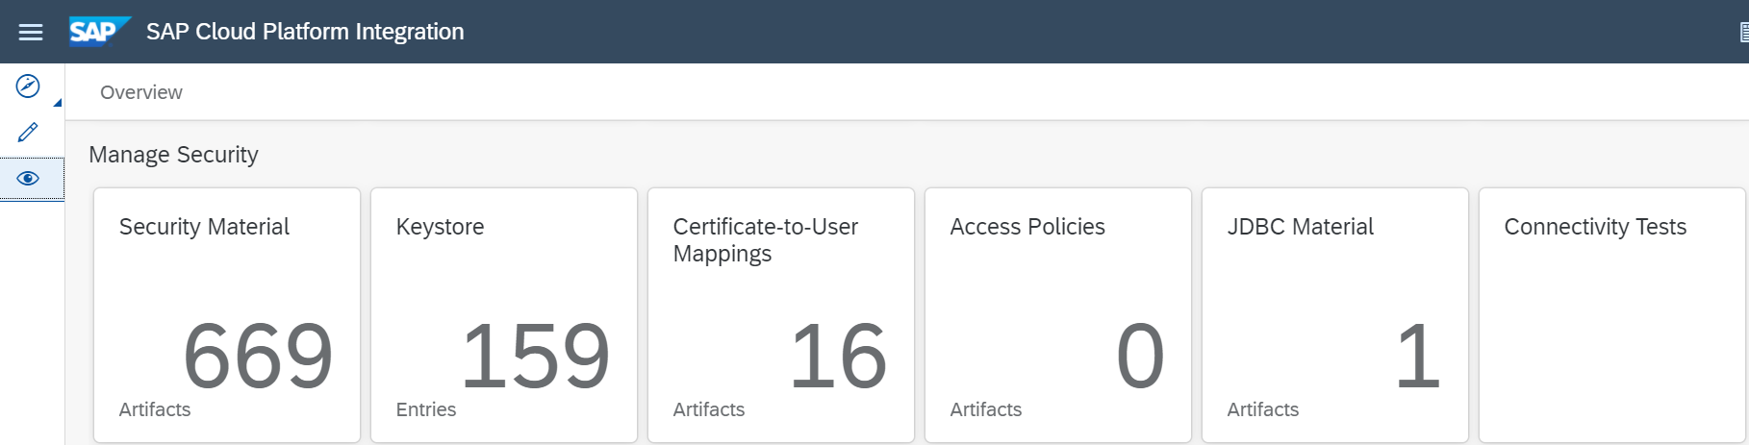
4.Manage – Security
The Manage Security section allows us manage certain tasks related to the setup of secure connections between your tenant and remote systems.
Below tiles allows us to deploy and manage artifacts.
Security Material
Keystore
Certificate-to-User Mappings
Access Policies
JDBC Data stores
Connectivity Tests

Slide 17
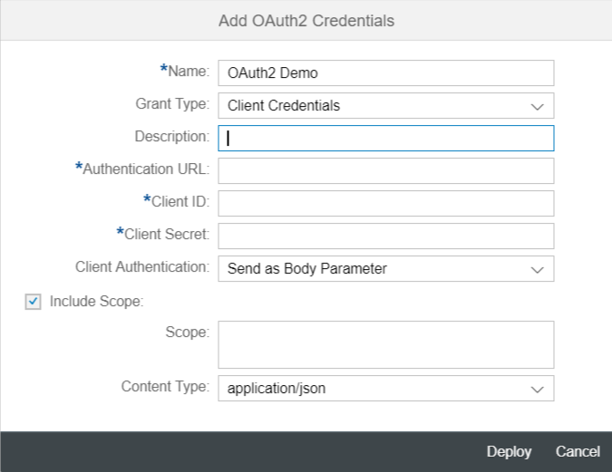
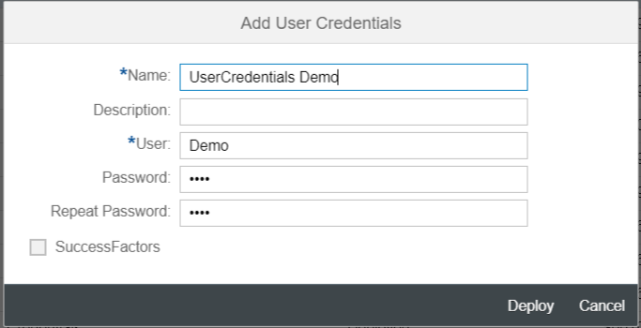
4a. Security Material
Security material provides access to and allows you to deploy security-related artifacts of various types such as
User Credentials: To store the Username and Password and call it in adapters through Alias.
OAuth2 Credentials: Framework that enables a third-party application to obtain limited access to an HTTP service, either on behalf of a resource owner by orchestrating an approval interaction between the resource owner and the HTTP service.
More details on Oauth is available in https://tools.ietf.org/html/rfc6749

Slide 18
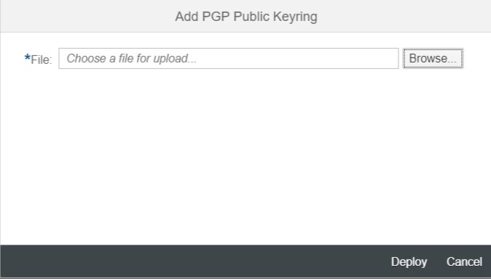
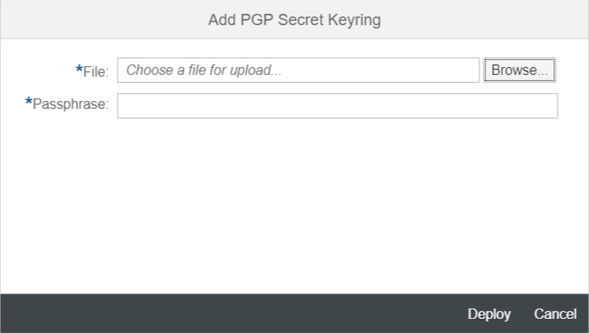
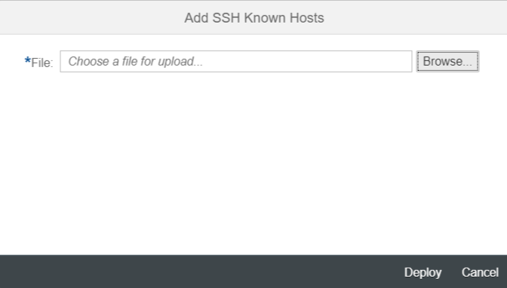
4a. Security Material
PGP Public and Secret Keyring: It allows to store public and private key pair for the usage of Open Pretty Good Privacy (PGP). These keys enables the tenant to Encrypt/decrypt or sign messages.
Private/Secret Keyring requires passphrase that was used during generation of the keyring during deployment
Known Hosts(SSH): This artifact type specifies the known hosts file used when configuring secure connectivity based on SSH File Transfer Protocol (SFTP).

Slide 19
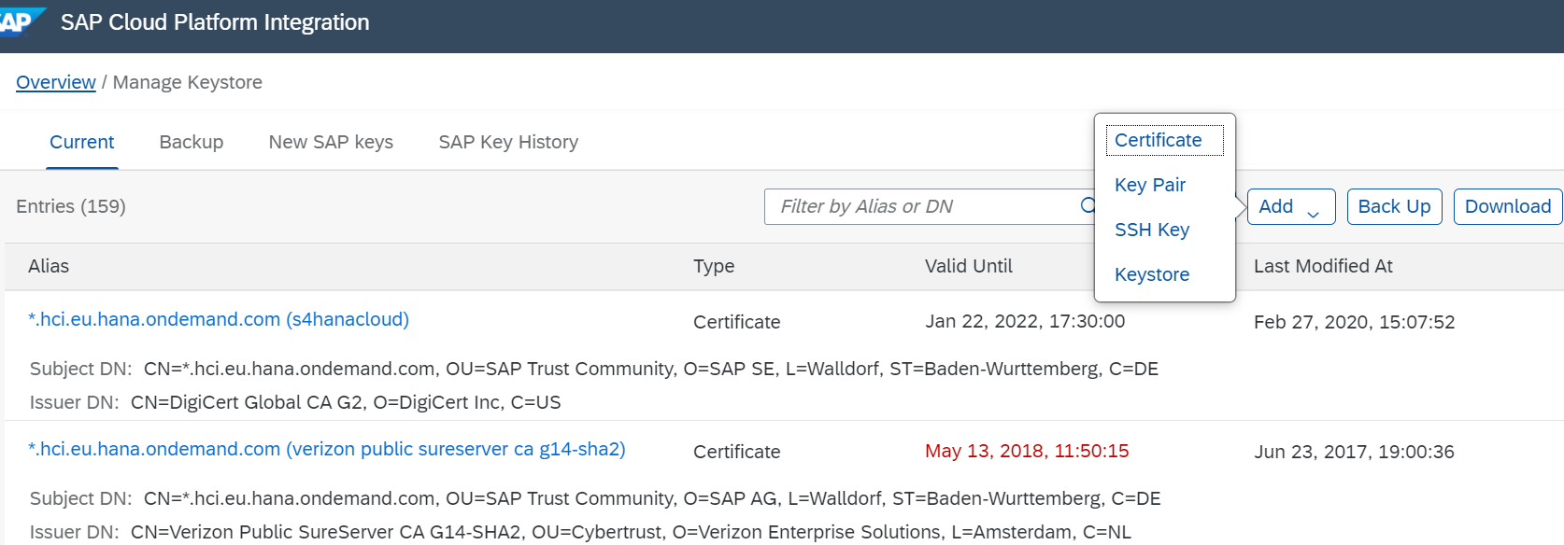
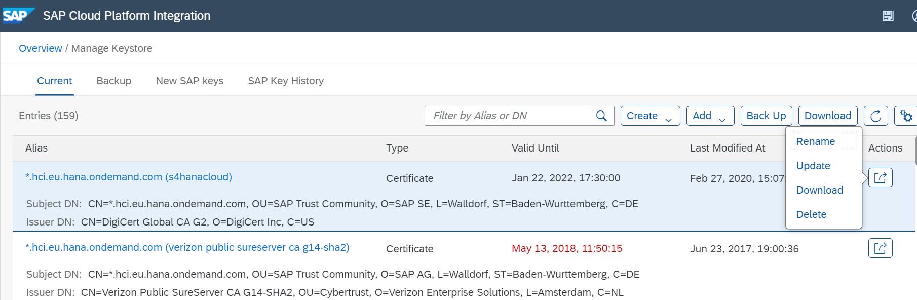
4b. Key Store
Keystore provides access to the content of the tenant keystore and allows you to manage its content and also the lifecycle of keys and certificates.
Key pairs and SSH key’s can be created using keystore in CPI
We can add Keystore view and import Keypair’s and Certificate’s into the view added.
Various actions can be performed in the existing Certificates/Keypair such as Update, Rename, Download and Delete.
Backup of all the entries within the keystore of a tenant can be created.

Slide 20
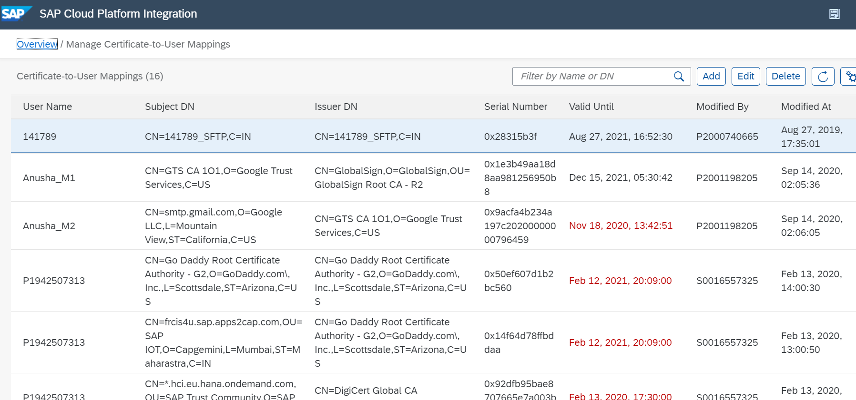
4c. Certificate-to-User Mapping
A list of certificate-to-user mappings is displayed in a table. For each artifact, the following attributes are displayed:

Slide 21
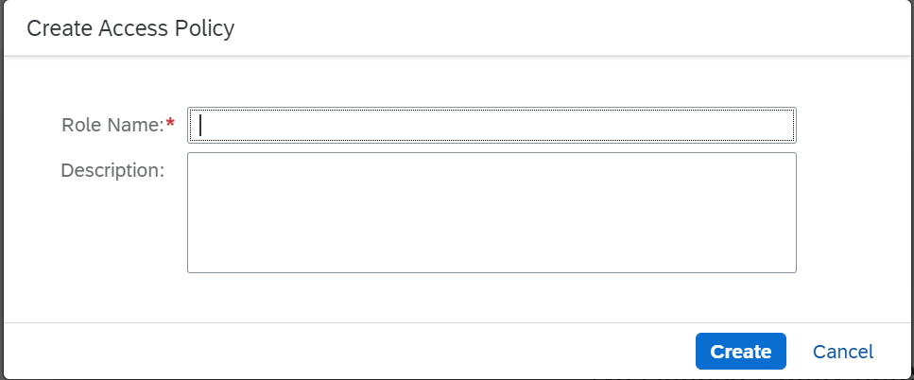
4d. Access policies
The Access Policies monitor allows you to show and maintain access policies.
In SAP Cloud Integration, user permissions are granted based on tasks that can be performed on all artifacts and data. Access policies provide a way to additionally protect a subset of artifacts and data.
Access policies are coupled with custom user roles. Thus, per group of integration flows that are to be accessible only for a specific group of users, you’ve to
Using SAP BTP cockpit, create a Custom Role for your TMN application.
You have to be an Administrator for your subaccount to maintain custom roles.Assign the role to users who are to get access once the access policies are active
Create an access policy containing references to all integration flows of the group.

Slide 22
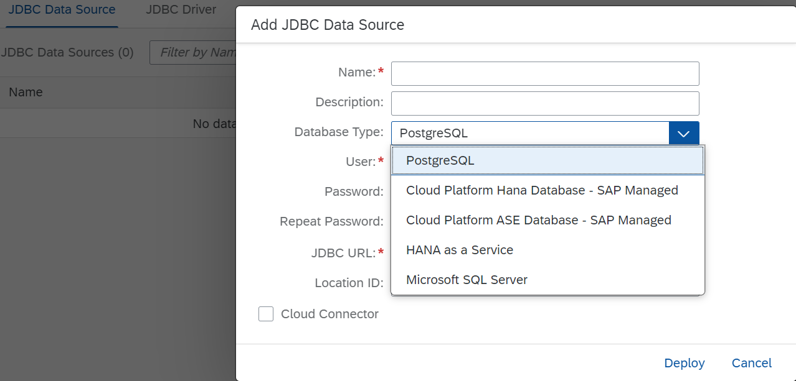
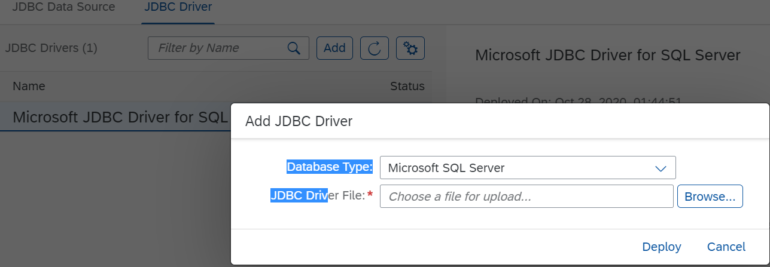
4e. JDBC Material
Use JDBC Data Source to establish connection with databases and JDBC Drivers helps you to upload and install third-party compliant JDBC type-4 drivers to connect with third-party databases.
The JDBC Data Sources allows you to create and manage a cluster of artifact connections to interact with a database
The tenant administrator configures JDBC drivers on your Cloud Integration tenant to enable you to establish connection to a database managed by a third-party vendor.

Slide 23
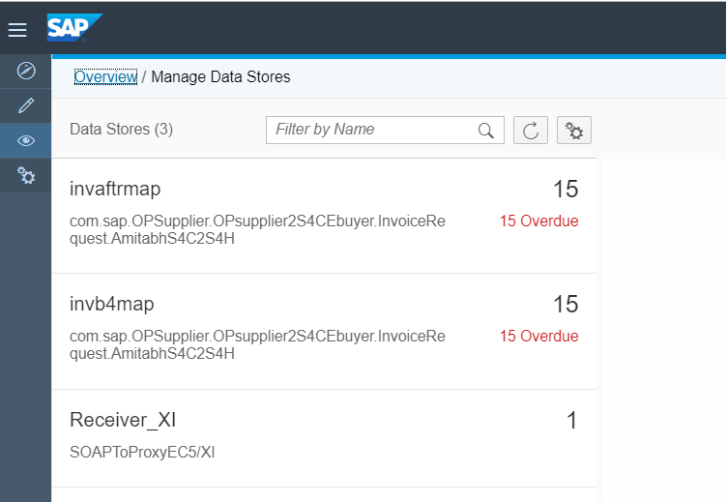
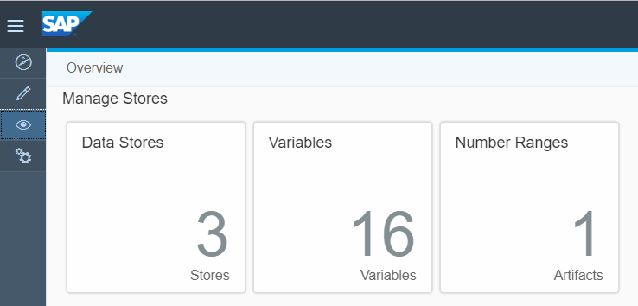
5.Manage Stores
Manage Stores allows us to manage temporary data storages on the tenant.
Data Stores provides an overview of storages on the tenant, which are temporarily used to persist data of different kind during message processing (when using the Data Store Operations step type from pallete).
The Variables tile allows you to monitor variables used in integration flows.
The Number Ranges tile provides an overview of number ranges that are used in business-to-business scenarios.
Data’s stored using the data store operation in Iflow.

Slide 24
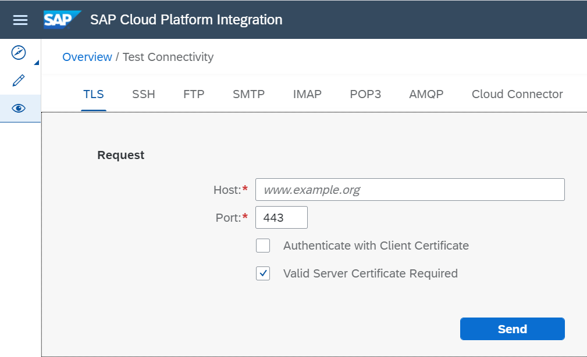
6. Test Connectivity
The Connectivity Tests allows us to test the connectivity to a receiver system to find if the receiver (host) is reachable for the tenant using various types TLS, SSH, FTP,SMTP,IMAP, POP3,AMQP,Cloud Connector.
Prerequisites are KeyStore should be deployed correctly with necessary Keys/Certificate based on Authentication that are required for during TLS handshake.
Host: Enter the host name of the receiver.
The host name must not contain any path or schema
Port:Enter the port that is to be used for outbound communication
Authenticate with Client Certificate(Optional): If client is to be authenticated against the receiver (server) during the TLS handshake(a mutual authentication)
Validate Server Certificate: Validates two parameters,
If the server certificate belongs to the server the client connects to
If the certificate is signed by an instance the client trusts
TLS CONNECTIVITY TEST

Slide 25
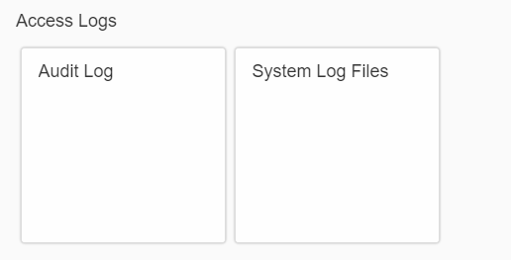
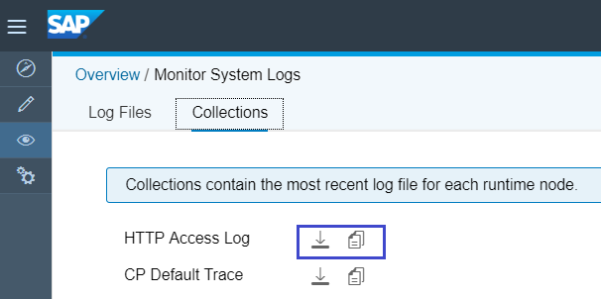
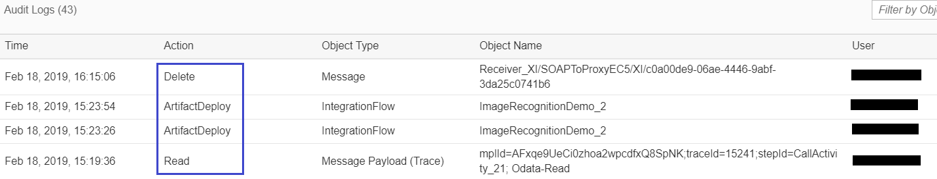
7.Logs
Audit Log: Allow you to monitor audit logs (resulting from system changes) and to analyse errors that occurred during inbound HTTP processing (and documented in system log files).
System Log Files: Allows you to display and manage lock entries that are created (in the in-progress repository) to avoid the same message being processed several times in parallel.
These log files can be either HTTP access files or Cloud Platform default trace files.

Slide 26


